Slide 1
Improving School Hours
An Approach To Impact Student Achievement
Community Forums
Notes:
Welcome!
Glad to have discussion focused on improving school hours.
We are here to share the district’s current version.
We are here to hear and gather more feedback from you.
7000 Surveys completed
250 Comments on website
200+ Postings on Facebook and Twitter

Slide 2

Welcome!
Notes:
Introductions!
Natasha Newcomb
Deonna Langford
Terri Caldwell
Cindy Esbernd
Rob Barron
Connie Boesen

Slide 3
Forum Outcomes
  Understand why adjustments to school hours are being proposed
  Know the timeline for communication, input and decision making
  Provide additional feedback and questions to help inform next steps

Slide 4
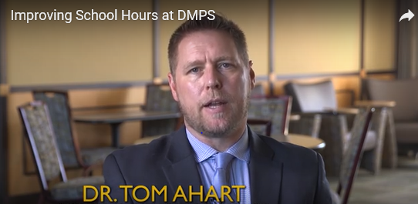
Dr. Tom Ahart
Notes:
Message from superintendent to frame discussion and give context to forum.

Slide 5


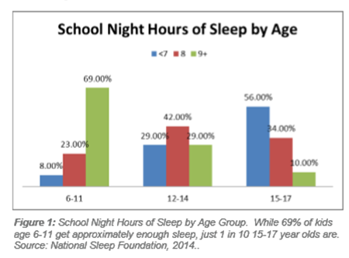

Research Summary
The body of evidence concerning the academic and health benefits of adjusted school hours for students is compelling.
Notes:
Tim –
National Sleep Foundation
American Psychological Association
American Academy of Pediatrics
American Medical Association
Hanover Research Group

Slide 6
American Medical Association - 2016
  "Sleep deprivation is a growing public health issue affecting our nation's adolescents…"Scientific evidence strongly suggests that allowing adolescents more time for sleep at the appropriate hours results in improvements in health, academic performance, behavior, and general well-being. “
Notes:
Tim - Read

Slide 7
American Medical Association - 2016
  "We believe delaying school start times will help ensure middle and high school students get enough sleep, and that it will improve the overall mental and physical health of our nation's young people.“
Notes:
Tim – Read
Counter The Impact Of Sleep Deprivation – Adolescents
70% Elementary
30% Middle
10% High

Slide 8
Positive Benefits For Adolescents
Student Learning | Health and Well Being | Disproportionate Impact
Attendance First Period Grades Standardized Assessments | Obesity Depression Impulse Control Drowsy Driving At-Risk Behaviors | Less Privileged Students Transportation Attendance Breakfast
Notes:
Tim – Left To Right
Disproportionate – Students Living in Poverty
DMPS – 2-3X more likely to be absent 1st period
Low participation in Breakfast

Slide 9

Positive Benefits For Elementary
Optimal Learning Time
Less Need For Morning Care
Enriched After School Care Options
More Consistent Professional Development Time For Staff
More efficient use of buses
Notes:
Susie
Align with sleep cycles
More focused earlier in the morning

Slide 10
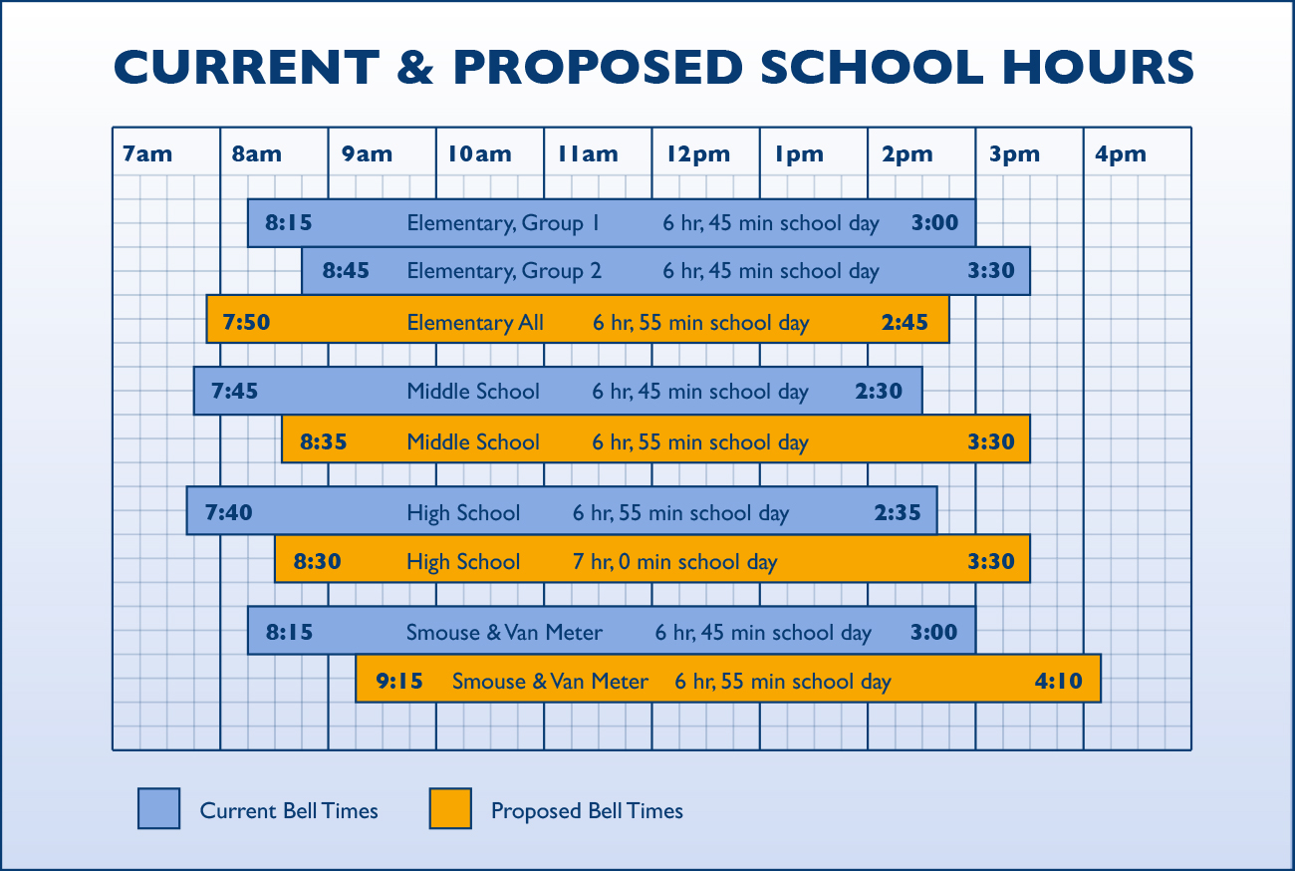
Hours
Notes:
Susie

Slide 11
Initial Stakeholder Feedback
"It's about time."
Alignment of Hours
Optimal Learning Time
Research-Based
Notes:
Susie – Early Themes

Slide 12
Initial Stakeholder Feedback
Elementary Walkers
Sibling Childcare
Evening Impact
  Jobs
  Activities
Notes:
Tim – Concerns

Slide 13
Timeline
January
Board Information and Input
March
Revisions and Updates
April
Final Decision
February-March
Stakeholder Feedback
Notes:
Tim –
Continuous Improvement Project
Past Few Months - Internal Stakeholders and DART
Next Few Months – Board/Stakeholders Feedback = Revisions
Determination of If and When = Early April

Slide 14
Resources
http://www.dmschools.org/school-hours-at-dmps/
Notes:
Tim – Web Site Has Growing Resources
Dr. Ahart Introduction
Research Summaries
FAQ
Surveys in 8 Languages

Slide 15
Comment/Question Process
3x5 Cards
Phase 1 = Comments
Phase 2 = Questions/Discussion
Elementary – Susie
Secondary – Tim
Notes:
Tim – How Process Feedback & Questions

