Slide 1
Central Campus Final Plans Lower level renovation
Board Meeting
November 15, 2016

Slide 2
Site Plan

Slide 3
Overall floor plan

Slide 4
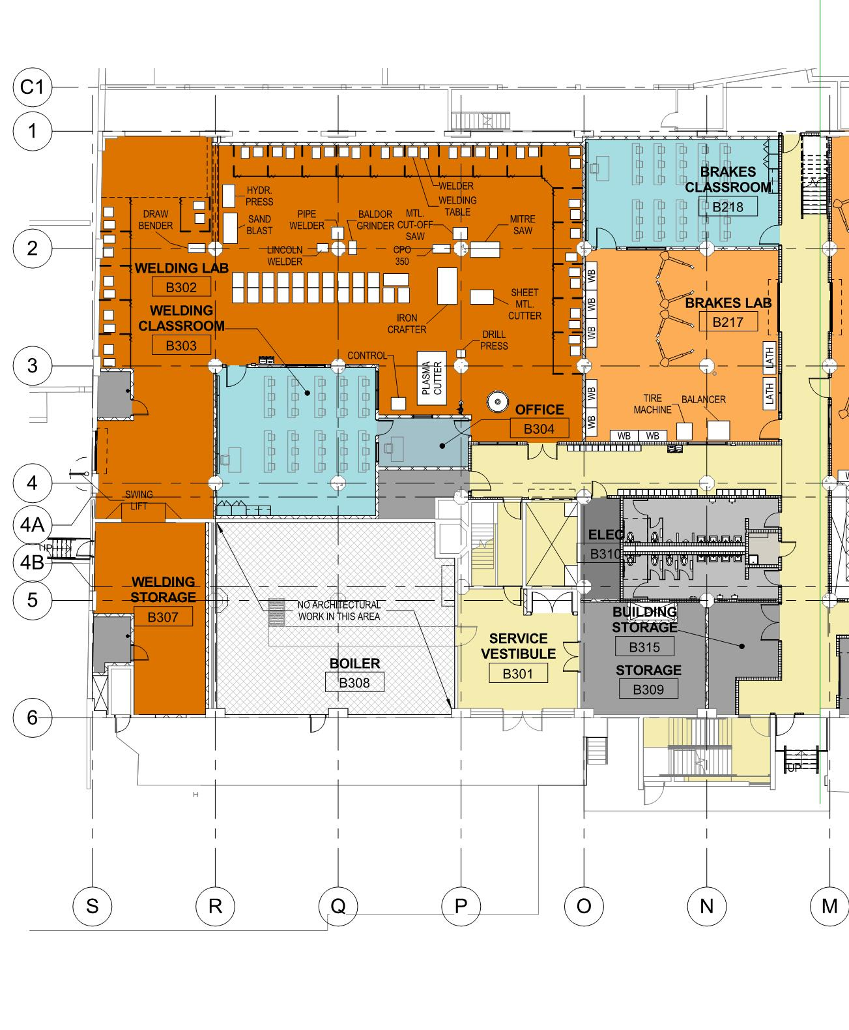
WELDING

Slide 5
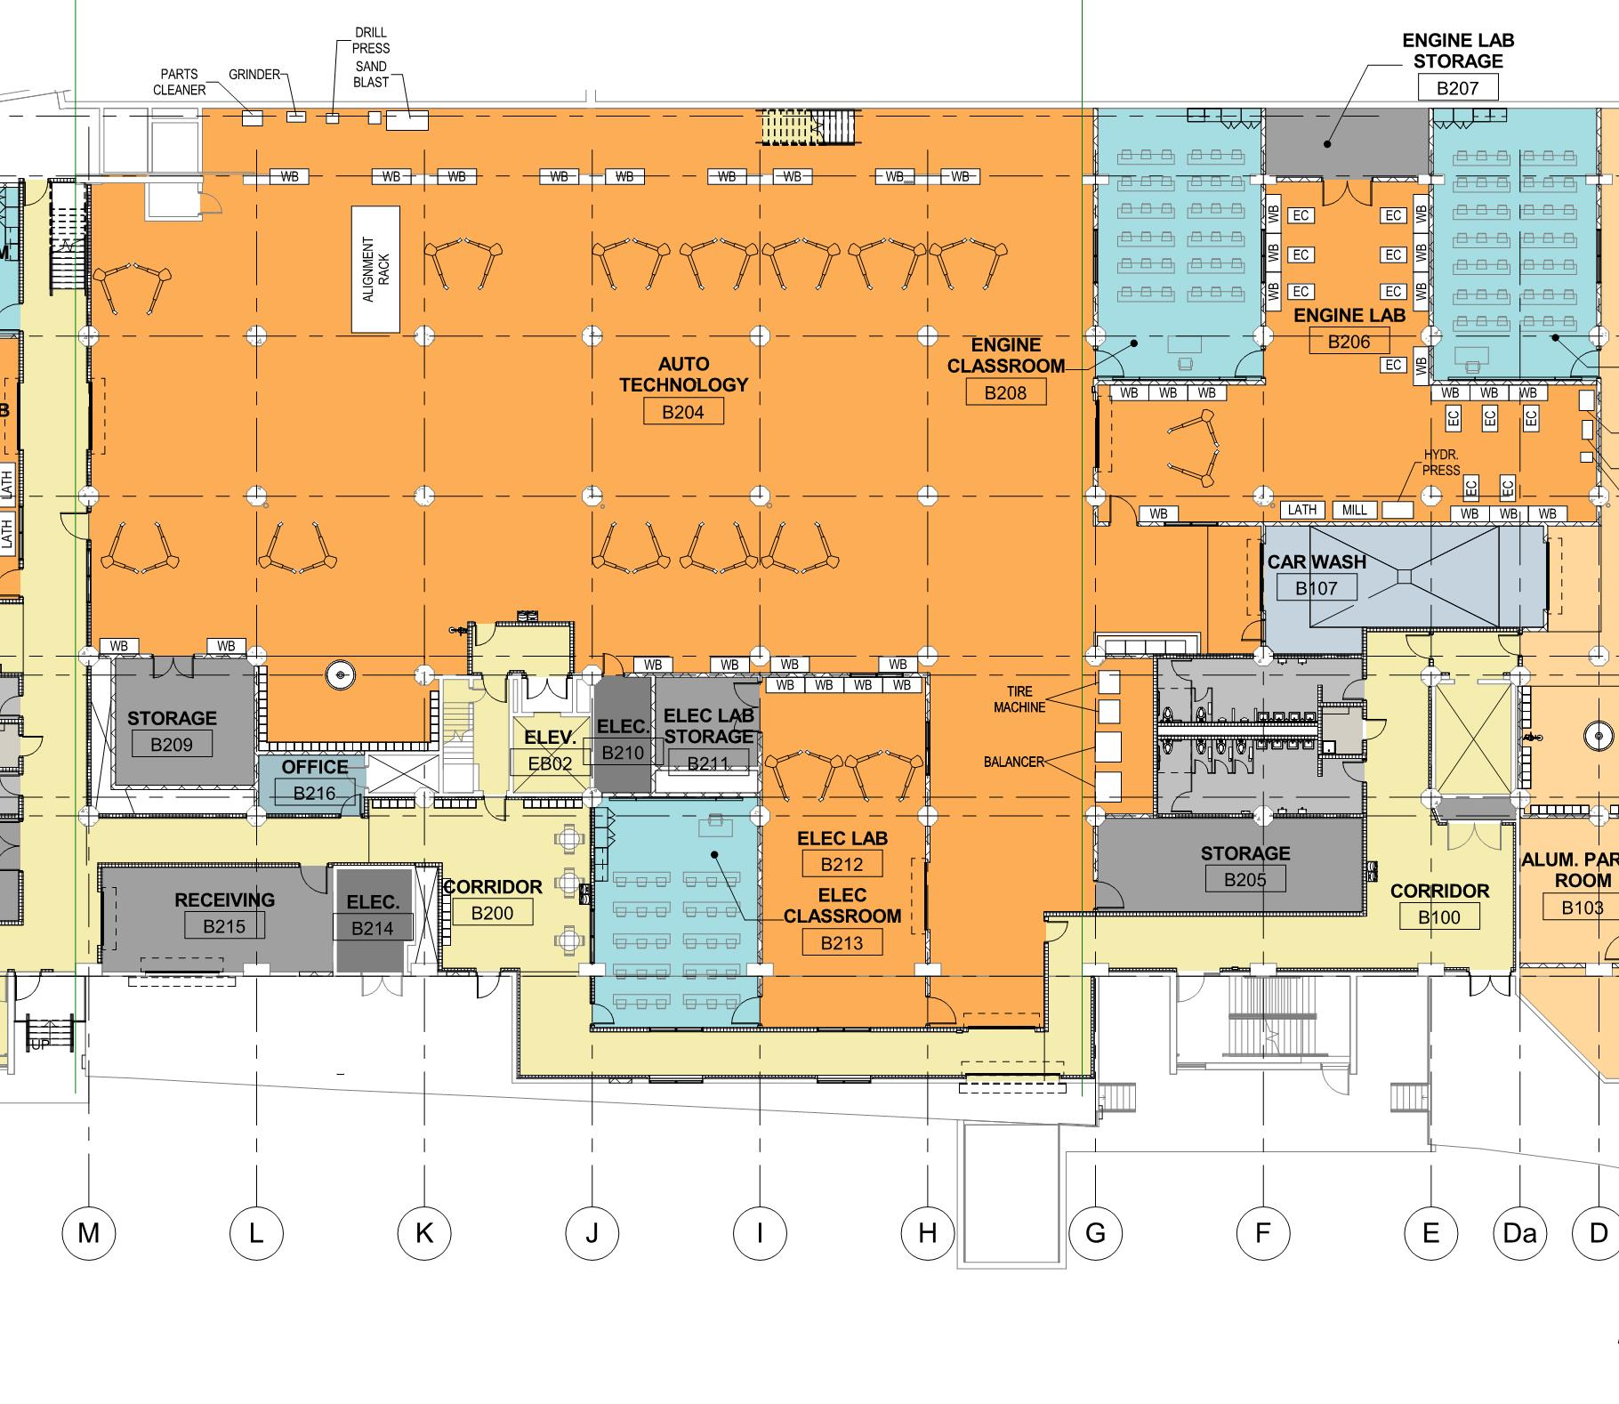
AUTO TECHNOLOGY

Slide 6
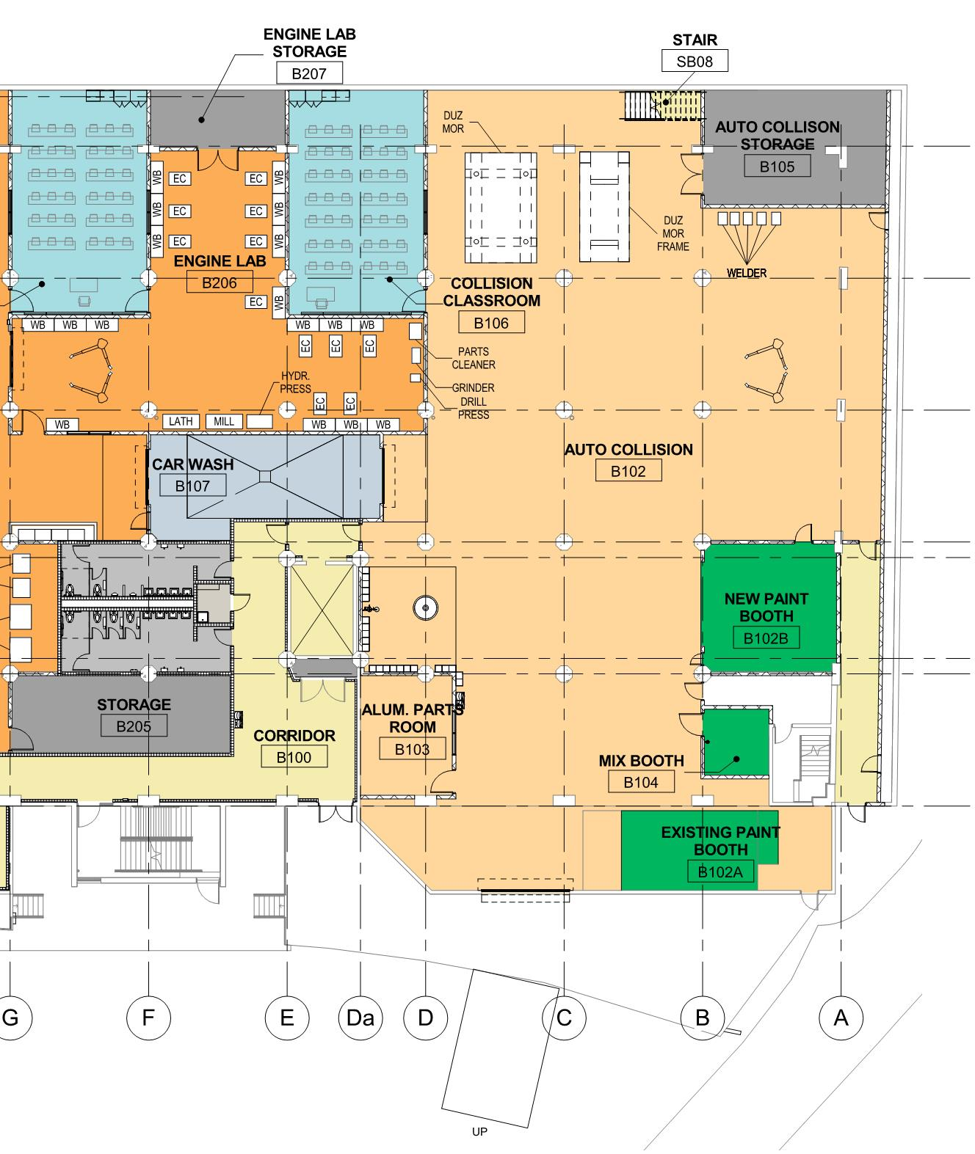
AUTO COLLISION

Slide 7
Highlights of project
Premier Regional Academy to the next level of learning opportunities.
High Tech and Modern Facilities/Equipment
225K Gift from MidAmerican Energy in Equipment
High quality pre-apprenticeships and Registered Apprenticeships
Certified Applied Work Based Learning Programs (Future Ready Iowans)
Recruitment & Retention of Diverse Learners

Slide 8
Timeline
November 15, 2016 – Board review and approval of final plans
January, 2017 – Construction start
January 2018 – Completion
Project budget – Estimated $6,000,000
Funding – Year 2 of SWP plan

